Slide 1
Lecture - 3
Chapter 5: Series dc Circuits
(Part 1)
*
1

Slide 2
This lecture includes:
5.1 Introduction
5.2 Series Resistors
5.3 Series Circuits
5.4 Power Distribution in a Series Circuit
5.5 Voltage Sources in Series
5.6 Kirchhoff’s Voltage Law
*
2

Slide 3
Objectives
Become familiar with the characteristics of a series circuit
Learn to solve for the voltage, current, and power to each of the elements of a given circuit.
Understand the Power Distribution in a Series Circuit
Learn to deal with Voltage Sources in Series
Develop a clear understanding of Kirchhoff’s voltage law and how important it is to the analysis of electric circuits.
*
3

Slide 4
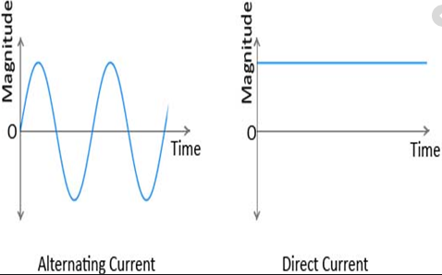
5.1 Introduction
There are two types of current : dc and ac
In case of direct current (dc), the flow of charge (current) does not change in magnitude (or direction) with time.
In case of alternating current (ac), the flow of charge is continually changing in magnitude (and direction) with time.
*
4

Slide 5
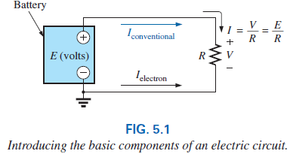
5.1 Introduction
As long as the battery is connected in the circuit, the current (dc) through the circuit will not change in magnitude or direction.
The potential difference V across the resistor will equal the applied voltage of the battery V (volts) = E (volts) as shown in the figure.
Current then is limited only by the resistor R. The higher the resistance, the less the current (Ohm’s Law).
*
5

Slide 6
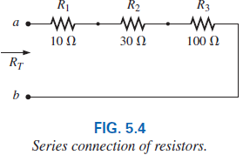
5.2 Series Resistors
Every fixed resistor has only two terminals to connect in a configuration—referred to as a two-terminal device.
In Fig. 5.4, one terminal of resistor R₂ is connected to resistor R₁ on one side, and the remaining terminal is connected to resistor R₃ on the other side, resulting in one, and only one, connection between adjoining resistors.
When connected in this manner, the resistors have established a series connection.
*
6
Notes:
6

Slide 7
5.2 Series Resistors
For resistors in series, the total resistance of a series configuration is the sum of the resistance levels.
In equation form for any number (N) of resistors,
A result of Eq. (5.1) is that the more resistors we add in series, the greater the resistance, no matter what their value.
Further, the largest resistor in a series combination will have the most impact on the total resistance.
It is important to realize that since the parameters of Eq. (5.1) can be put in any order, the total resistance of resistors in series is unaffected by the order in which they are connected.
*
7
Notes:
7

Slide 8

5.2 Series Resistors
For the special case where resistors are the same value, Eq. (5.1) can be modified as follows:
where N is the number of resistors in series of value R.
*
8
Notes:
8

Slide 9

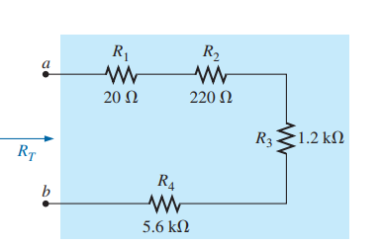
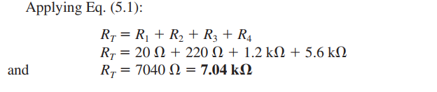

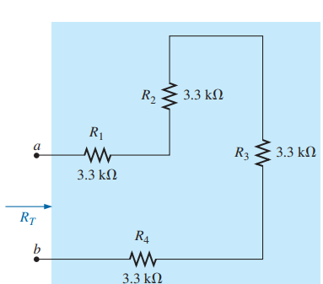

Example 5.1, 5.2 and 5.3
*
9

Slide 10
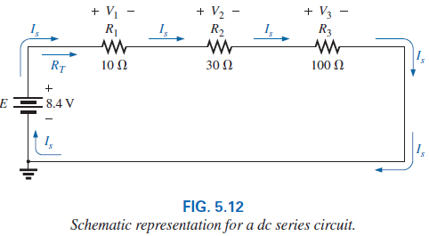
5.3 Series Circuits
If a dc supply is connected in series with the series resistors, we have the series circuit.
*
10
Notes:
10

Slide 11

5.3 Series Circuits
The manner in which the supply is connected determines the direction of the resulting conventional current.
The current is the same at every point in a series circuit.
The level of current and the voltage across each resistor should be determined using Ohm’s law and replace the resistance in the equation by the total resistance of the circuit. That is,
*
11
Notes:
11

Slide 12
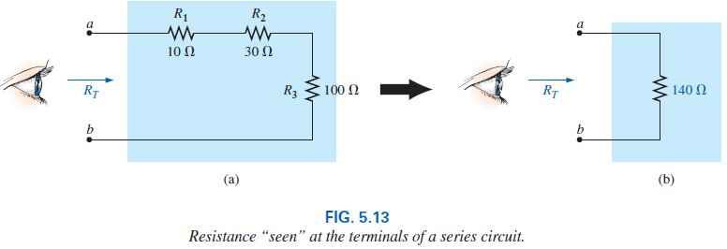
5.3 Series Circuits
It is important to realize that when a dc supply is connected, it does not “see” the individual connection of elements but simply the total resistance “seen” at the connection terminals, as shown in Fig. 5.13(a).
In other words, it reduces the entire configuration to one such as in Fig. 5.13(b) to which Ohm’s law can easily be applied.
*
12
Notes:
12

Slide 13
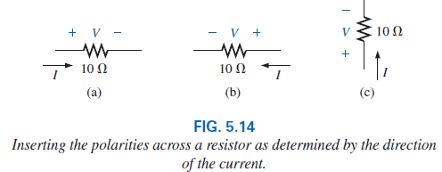
5.3 Series Circuits
After having the current level, the voltage across each resistor can be calculated. First recognize that
the polarity of the voltage across a resistor is determined by the direction of the current.
Current entering a resistor creates a drop in voltage with the polarity indicated in Fig. 5.14(a).
Reverse the direction of the current, and the polarity will reverse as shown in Fig. 5.14(b).
Change the orientation of the resistor, and the same rules apply as shown in Fig. 5.14(c).
*
13
Notes:
13

Slide 14

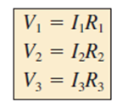

5.3 Series Circuits
The magnitude of the voltage drop across each resistor can then be found by applying Ohm’s law using only the resistance of each resistor. That is,
R_{T} = R₁ +R₂ +R₃
= (10 + 30 + 100) Ω
=140 Ω
*
14
Notes:
14

Slide 15
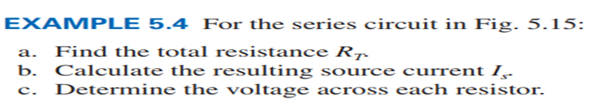
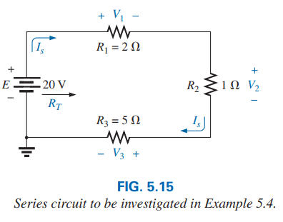
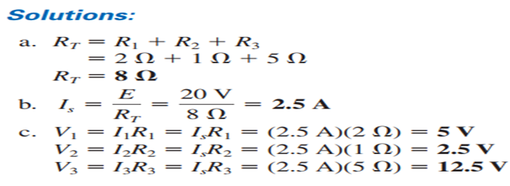
Example: 5.5, 5.6
*
15

Slide 16
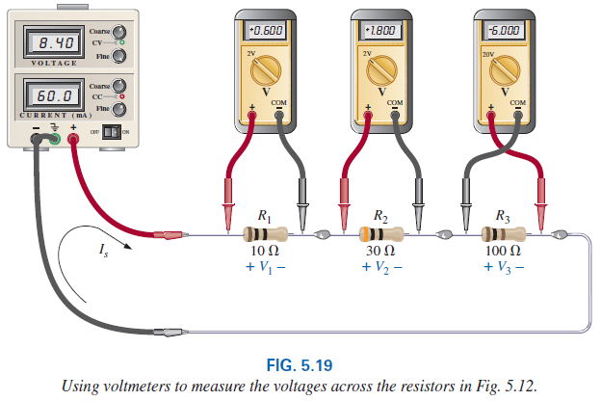
5.3 Series Circuits: Instrumentation
In Fig. 5.19, all the voltages are being measured by voltmeters that were connected without disturbing the original configuration. Note that all the voltmeters are placed across the resistive elements.
In addition, note that the positive (normally red) lead of the voltmeter is connected to the point of higher potential (positive sign), with the negative (normally black) lead of the voltmeter connected to the point of
*
16

Slide 17
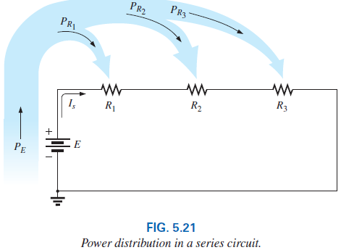

5.4 Power Distribution in a Series Circuit
In any electrical system, the power applied will equal the power dissipated or absorbed.
For any series circuit, such as that in Fig. 5.21, the power applied by the dc supply must equal that dissipated by the resistive elements.
In equation form,
*
17
Notes:
17

Slide 18
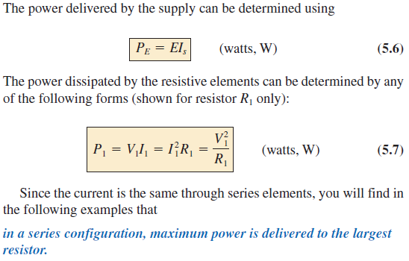
5.4 Power Distribution in a Series Circuit
Example 5.7
*
18

Slide 19
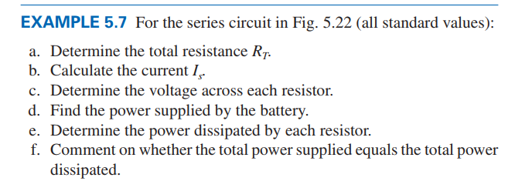
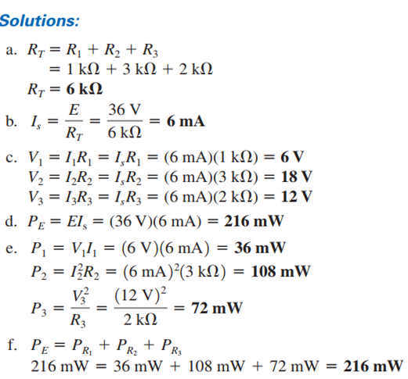
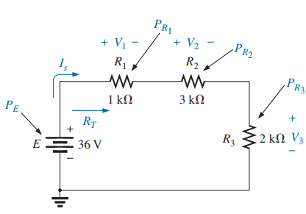
*
19

Slide 20
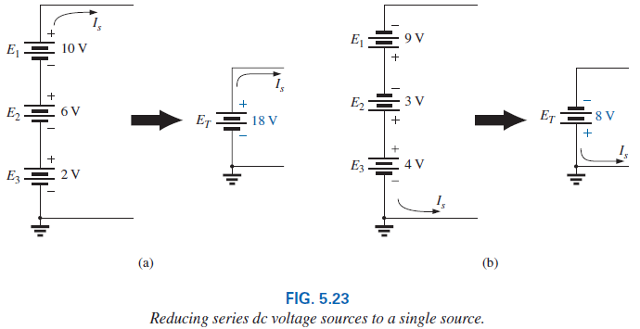
5.5 Voltage Sources in Series
Voltage sources can be connected in series, as shown in Fig. 5.23, to increase or decrease the total voltage applied to a system.
The net voltage is determined by summing the sources with the same polarity and subtracting the total of the sources with the opposite polarity. The net polarity is the polarity of the larger sum.
*
20
Notes:
20

Slide 21
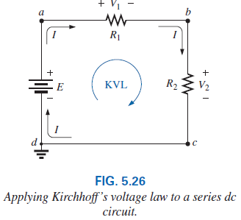
5.6 Kirchhoff’s Voltage Law
Kirchhoff’s voltage law (KVL) states that the algebraic sum of the potential rises and drops around a closed loop (or path) is zero.
A closed loop is any continuous path that leaves a point in one direction and returns to that same point from another direction without leaving the circuit.
The path does not have to be circular, square, or any other defined shape.
*
21
Notes:
21

Slide 22

5.6 Kirchhoff’s Voltage Law
In symbolic form, where Σ represents summation, the closed loop, and V the potential drops and rises, we have
The term algebraic simply means paying attention to the signs that result in the equations as we add and subtract terms.
KVL was developed by Gustav Kirchhoff in the mid-1800s.
*
22
Notes:
22

Slide 23
5.6 Kirchhoff’s Voltage Law - Questions
1. Which way should I go around the closed path? Should I always follow the direction of the current?
To simplify matters, we will always try to move in a clockwise direction.
By selecting a direction, we eliminate the need to think about which way would be more appropriate.
Any direction will work as long as you get back to the starting point.
2. How do I apply a sign to the various voltages as I proceed in a clockwise direction?
For a particular voltage, we will assign a positive sign when proceeding from the negative to positive potential.
The opposite change in potential level results in a negative sign.
*
23
Notes:
23

Slide 24
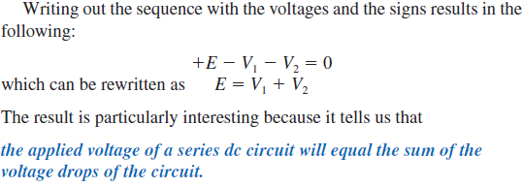
5.6 Kirchhoff’s Voltage Law
In Fig. 5.26, as we proceed from point d to point a across the voltage source, we move from a negative potential (the negative sign) to a positive potential (the positive sign), so a positive sign is given to the source voltage E.
As we proceed from point a to point b, we encounter a positive sign followed by a negative sign, so a drop in potential has occurred, and a negative sign is applied.
Continuing from b to c, we encounter another drop in potential, so another negative sign is applied.
We then arrive back at the starting point d, and the resulting sum is set equal to zero as defined by Eq. (5.8).
*
24
Notes:
24

Slide 25
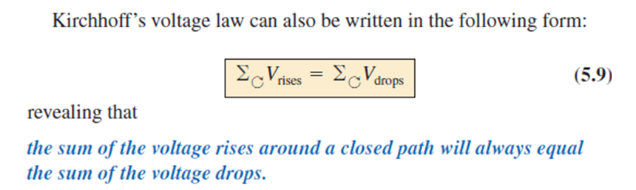
5.6 Kirchhoff’s Voltage Law
*
25
Notes:
25

Slide 26
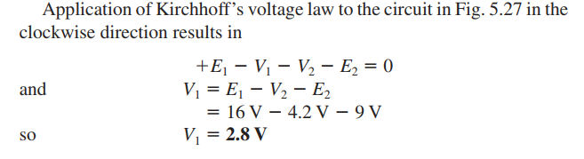
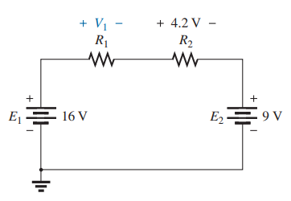
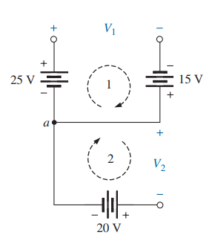
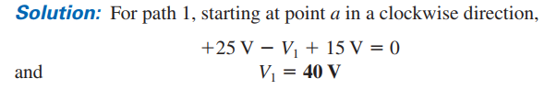
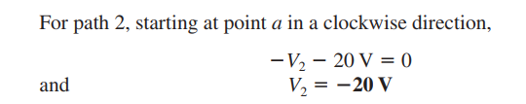
Practice Example 5.11
*
26

Slide 27
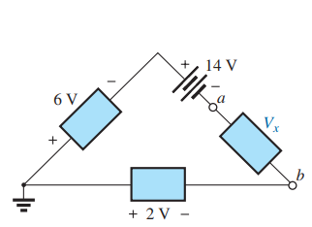
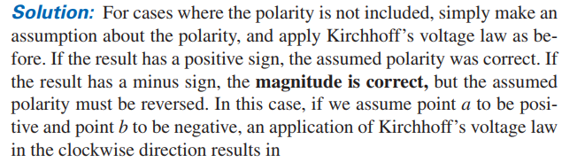
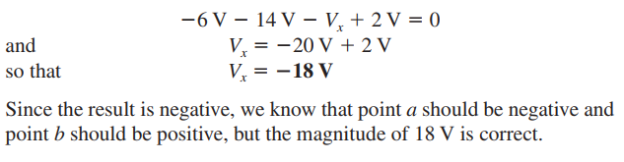
*
27

Slide 28
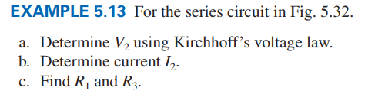
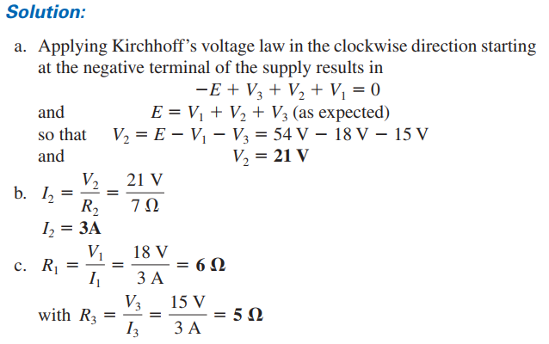
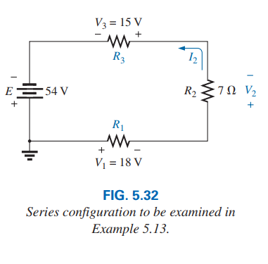
Practice Example 5.14
*
28

Slide 29
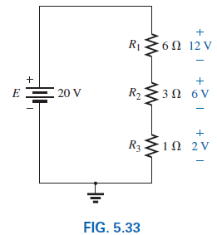
5.7 Voltage Division in a Series Circuit
How will a resistor’s value affect the voltage across the resistor?
It turns out that the voltage across series resistive elements will divide as the magnitude of the resistance levels.
In other words, in a series resistive circuit, the larger the resistance, the more of the applied voltage it will capture.
*
29
Notes:
29

Slide 30
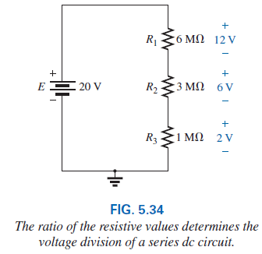
5.7 Voltage Division in a Series Circuit
In addition, the ratio of the voltages across series resistors will be the same as the ratio of their resistance levels.
Note that if the resistance levels of all the resistors in Fig. 5.33 are increased by the same factor, as shown in Fig. 5.34, the voltage levels all remain the same.
*
30
Notes:
30

Slide 31
Thank You
*
31

